Slide 1

Exploratory Data Analysis (EDA) on Healthcare Data
Karam Singh A41105220024
B.Tech (CSE)

Slide 2
Content
Introduction to EDA
Importance of EDA
Types of Healthcare Data for EDA
Data Collection and Preprocessing for Healthcare Analysis
Identifying correlations and relationships within healthcare data
Addressing Missing or Inconsistent Data in Healthcare Analysis
Tools and techniques for healthcare EDA
Visualization Techniques for Healthcare Data EDA
Statistical Analysis in Healthcare EDA
Ethical Considerations in Healthcare Data Analysis
Case Studies: EDA in Healthcare Success Stories
Conclusion & Future of EDA

Slide 3

Introduction to Exploratory Data Analysis (EDA)
Exploratory Data Analysis (EDA) is a crucial first step in analyzing healthcare data.
By using Python, EDA uncovers patterns, trends, and anomalies that can inform
decision-making. It enables data-driven insights to optimize healthcare processes
and improve patient outcomes.
Benefits of Exploratory Data Analysis
EDA helps in identifying missing or erroneous data, allowing for data cleaning and preprocessing.
It provides a preliminary understanding of the relationships between variables, enabling the selection of appropriate statistical techniques for further analysis.
EDA helps in detecting outliers and anomalies, which may require further investigation.
It assists in uncovering hidden patterns and trends in the data, leading to valuable insights for healthcare decision-making.

Slide 4

Importance of EDA in Healthcare Data
Cost Efficiency
Optimizing resources and reducing unnecessary expenses in healthcare operations.
Early Detection
Quality Improvement
Identifying patterns for early disease detection and intervention.
Enhancing healthcare processes and patient outcomes through data insights.
Uncovering Relationships
EDA uncovers relationships between various healthcare variables for in-depth analysis.

Slide 5




Types of Healthcare Data for EDA
Patient Data
Clinical Data
Biometric Data
Research Data
Personal health records, medical history, and demographic information.
Lab results, vital signs, diagnoses, and treatment plans.
Physiological measurements like heart rate, blood pressure, and glucose levels.
Studies, trials, and scientific research related to healthcare and medicine.

Slide 6
Data Collection and Preprocessing for Healthcare Analysis
Data Collection
1
Gather relevant healthcare data from various sources, including patient records, medical imaging, and clinical trials.
2
Data Cleaning
Clean the collected data by addressing missing values, outliers, and inconsistencies to ensure data quality.
Exploratory Analysis
3
Conduct initial exploration of the data to identify patterns, trends, and insights using statistical and visualization techniques.

Slide 7




Identifying correlations and relationships within Healthcare data
Correlation Analysis
Examining the strength and direction of relationships between healthcare variables.
Causal Inference
Investigating potential cause-and-effect relationships in healthcare data.
Pattern Recognition
Identifying recurring patterns and associations within complex healthcare datasets.

Slide 8
Addressing Missing or Inconsistent Data in Healthcare Analysis
Data Cleaning
Imputation Techniques
Identify and remove duplicate records or errors to ensure accuracy.
Use statistical methods to fill in missing data points.
Normalization
Validation Checks
Standardize data formats to minimize inconsistencies across sources.
Implement checks to ensure data integrity and consistency.

Slide 9
Tools and techniques for healthcare EDA
Machine Learning Algorithms
Utilize algorithms like Random Forest, Decision Trees, and Neural Networks to analyze complex healthcare data.
Data Visualization Tools
Use tools such as Tableau and Power BI to create interactive visualizations for better understanding of healthcare data.
Natural Language Processing
Apply NLP techniques to analyze unstructured healthcare data from sources like patient records and medical literature.
Big Data Analytics
Implement big data platforms like Hadoop and Spark to handle and analyze large volumes of healthcare data efficiently.

Slide 10
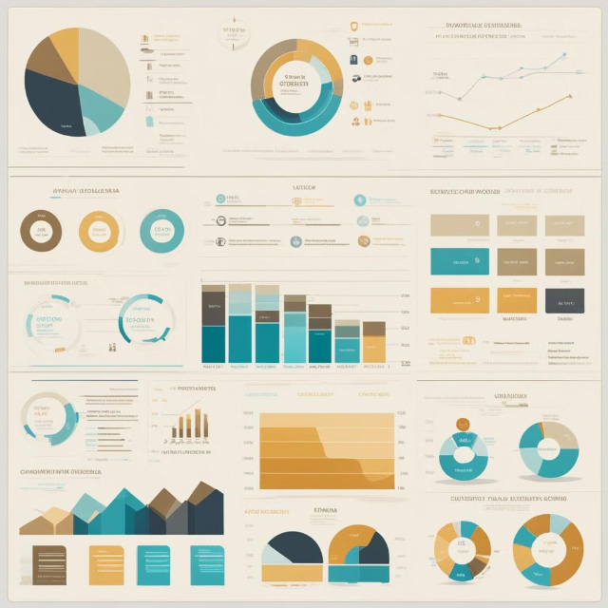
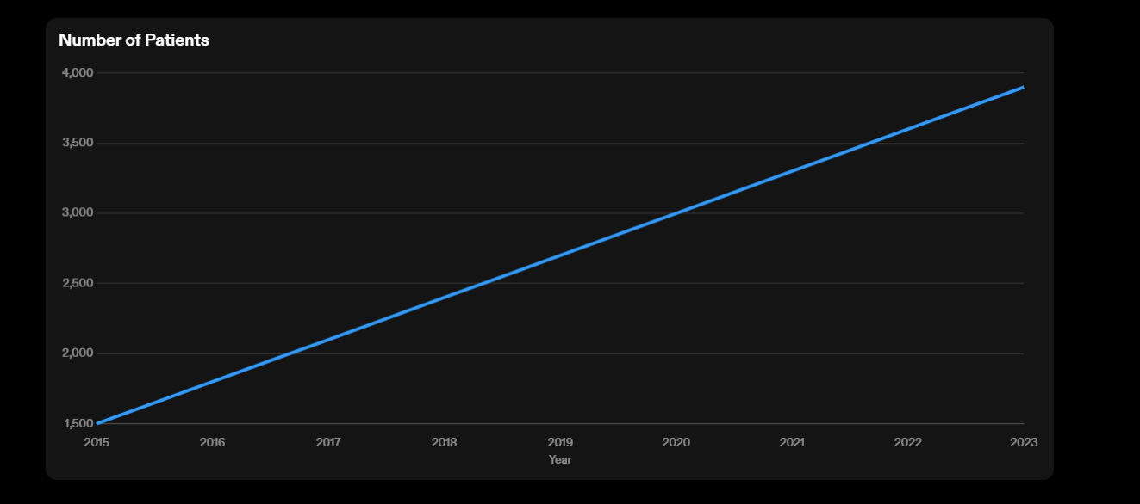
Visualization Techniques for Healthcare Data EDA
Visualization techniques in healthcare data EDA help in presenting complex medical information in a visually comprehensible manner. Techniques like scatter plots, heat maps, and patient journey maps offer insights into patient outcomes, disease trends, and treatment efficacy.

Slide 11
Statistical Analysis in Healthcare EDA
Descriptive Statistics
Inferential Statistics
Summarizing and describing healthcare data using measures like mean, median, and standard deviation.
Using sample data to make inferences or predictions about larger populations in healthcare research.
Hypothesis Testing
Regression Analysis
Evaluating the significance of relationships and effects in healthcare data analysis.
Examining the relationship between a dependent variable and one or more independent variables in healthcare datasets.

Slide 12
Ethical Considerations in Healthcare Data Analysis
Ethical considerations in healthcare data analysis are crucial for ensuring patient privacy and confidentiality. It's important to address issues of data security, informed consent, and responsible data usage. Healthcare professionals must navigate the ethical implications of utilizing sensitive patient information for research and analysis.
Transparency and accountability are key in ethical data analysis, ensuring that algorithms and models are fair and unbiased. Ethical considerations also extend to the responsible dissemination of findings to protect the well-being of individuals and communities.
It's essential to consider the potential impact of data misuse and prioritize patient autonomy and trust. Ethical frameworks guide decisions in handling healthcare data, promoting integrity and ethical responsibility in data analysis and decision-making.

Slide 13

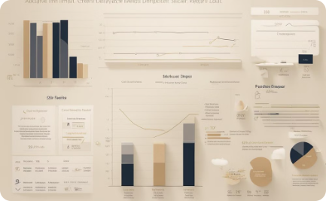

Case Studies: EDA in Healthcare Success Stories
Collaborative Healthcare Analysis
Visualizing Healthcare Data
Diversity in Data Analysis
A dedicated medical team discussing innovative EDA approaches for improved patient outcomes.
Data visualization leading to actionable insights, ultimately enhancing patient care and treatment.
A diverse group of healthcare professionals collaboratively analyzing data to uncover valuable insights.

Slide 14
Conclusion and Future of EDA in Healthcare
The exploratory data analysis on healthcare data has provided valuable insights and implications for the healthcare industry. The key findings are as follows:
1. Demographic Analysis: The analysis revealed important demographic trends, such as the aging population and the increasing prevalence of chronic diseases.
2. Disease Patterns: The analysis identified patterns in the occurrence and distribution of diseases, highlighting areas of concern and potential interventions.
3. Healthcare Access: The analysis shed light on disparities in healthcare access, particularly in underserved communities.
These findings have significant implications for healthcare providers, policymakers, and researchers. They can inform decision-making processes, resource allocation, and the development of targeted interventions to improve healthcare outcomes and address healthcare disparities.
Advancements in Technology
The future of EDA in healthcare will be shaped by advances in technology, including AI and machine learning.
These technologies will enable deeper insights and more accurate analysis of complex healthcare data.
Ethical Implications
As EDA becomes more sophisticated, ethical considerations regarding patient privacy and data security will need careful navigation.
Regulations and guidelines will play a crucial role in ensuring responsible use of healthcare data.

Slide 15

Any Questions?
Thank You ☺

